Slide 1
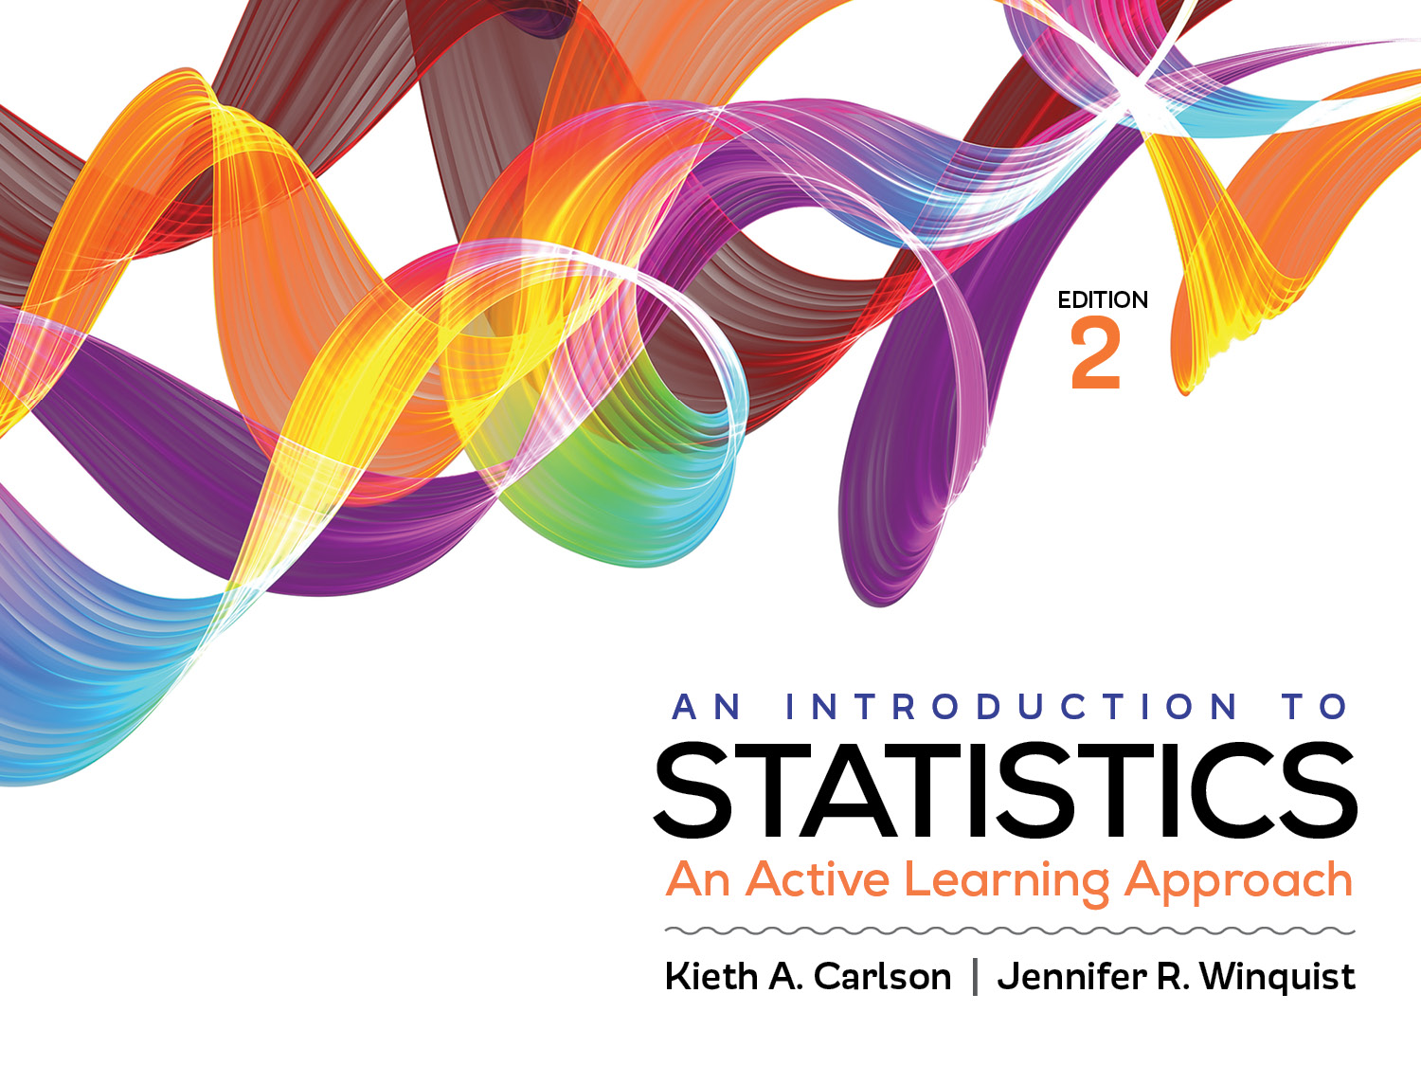
Introduction to Activity 4.1
Normal Curve and z-scores

Slide 2
Activity 4.1 will require you to:
Compute a z-scores for an individual score
Determine the probability of that z-score
Interpret that probability by determining if it is “likely” or “unlikely” to occur.

Slide 3
Normal Curve—a frequency distribution with a very specific shape
It is:
symmetrical
± 1 SD from mean contains 68% of scores
even if μ and σ are different
All of the area under the curve = 100%.

Slide 4
For example:
Distribution 1 has a μ = 50, σ = 10
So, 68% of all scores are between
the scores of ______ and ______ .
Distribution 2 has a μ = 25, σ = 5
So, 68% of all scores are between
the scores of ______ and ______ .
Z-scores are essentially standard
deviation units
Allow you to compare scores from
different distributions; a score of 60 in
distribution 1 is similar to a score of ____
in distribution 2.
10 20 30 40 50 60 70 80 90
5 10 15 20 25 30 35 40 45
Notes:
Point out that in distribution 1 a z score of +1 is 1 standard deviation (i.e., 10 points) higher than the mean. In distribution 2 a z score of +1 is 1 standard deviation (i.e., 5 points) higher than the mean. A score of 60 in distribution 1 is similar to a score of 30 in distribution 2 because both are 1 SD above their respective means.

Slide 5
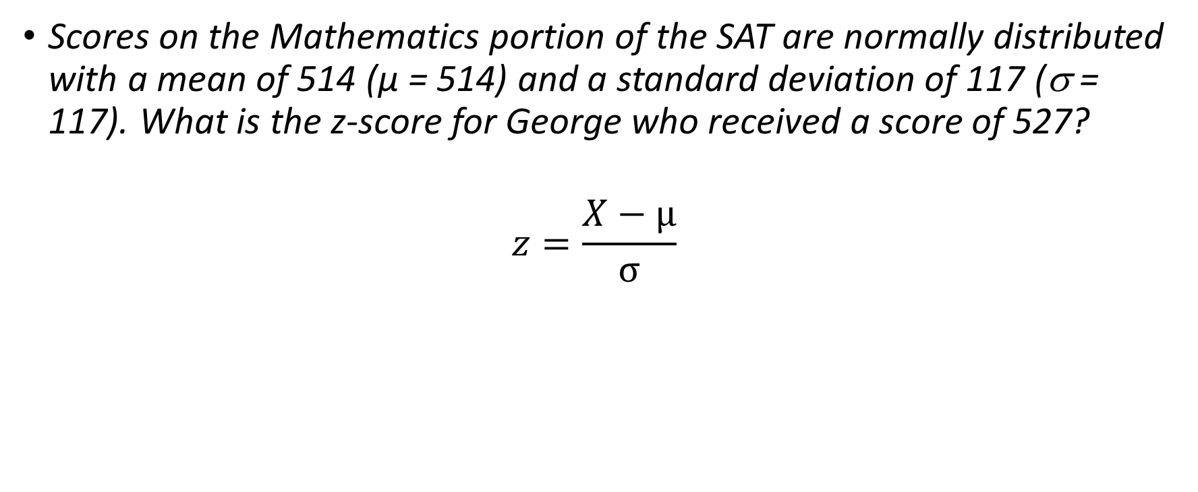
Computing z-scores
Scores on the Mathematics portion of the SAT are normally distributed with a mean of 514 (µ = 514) and a standard deviation of 117 (σ = 117). What is the z-score for George who received a score of 527?
$$z=\frac{X−μ}{σ}$$

Slide 6
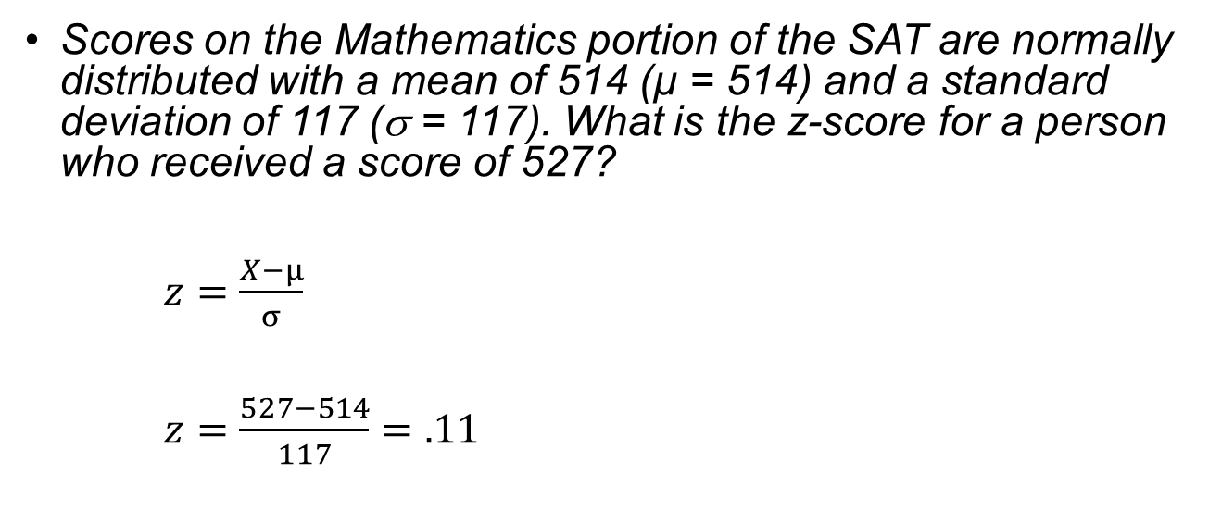
Computing z-scores
Scores on the Mathematics portion of the SAT are normally distributed with a mean of 514 (µ = 514) and a standard deviation of 117 (σ = 117). What is the z-score for a person who received a score of 527?
$z=\frac{X−μ}{σ}$
$z=\frac{527−514}{117}=.11$

Slide 7
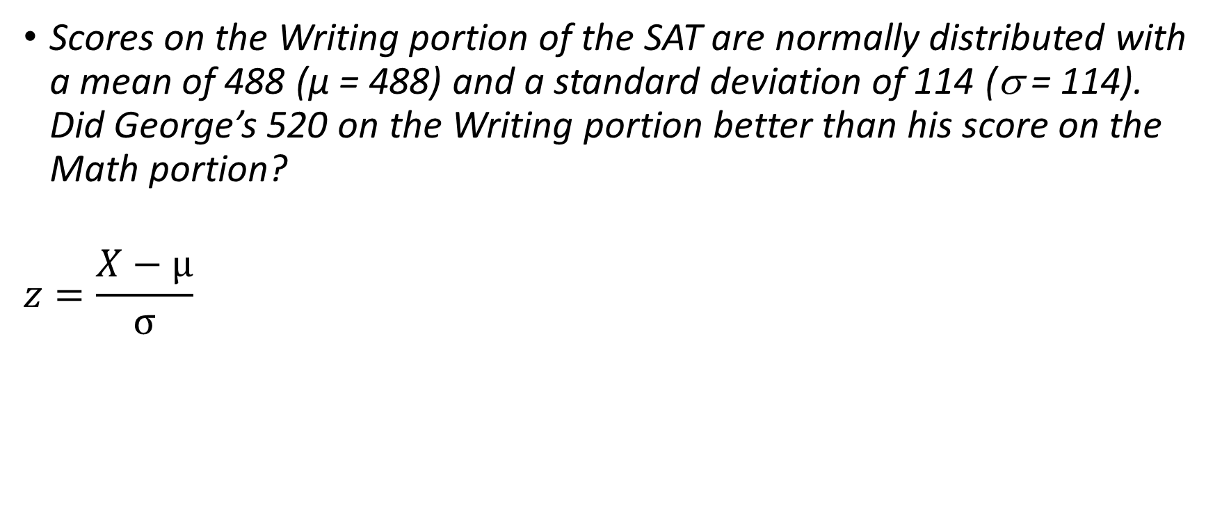
Computing z-scores
Scores on the Writing portion of the SAT are normally distributed with a mean of 488 (µ = 488) and a standard deviation of 114 (σ = 114). Did George’s 520 on the Writing portion better than his score on the Math portion?
$$z=\frac{X−μ}{σ}$$

Slide 8
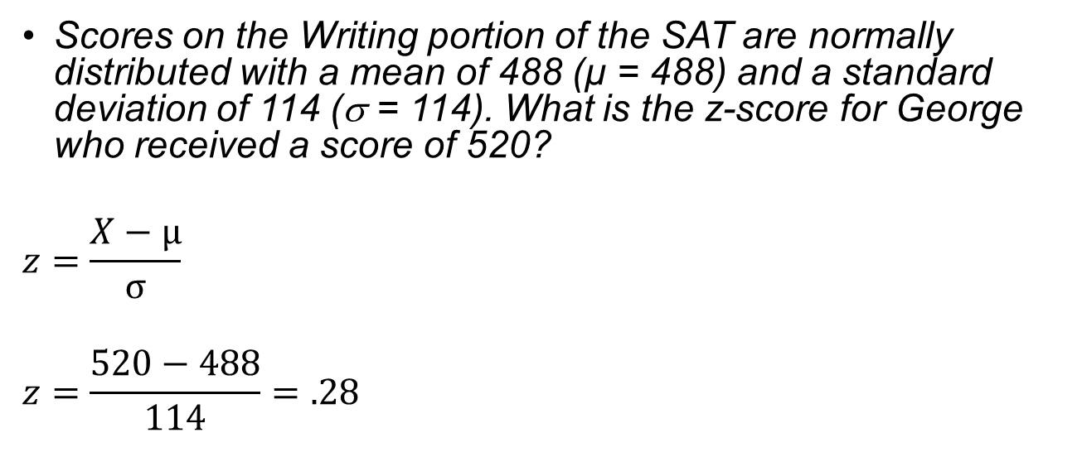
Computing z-scores
Scores on the Writing portion of the SAT are normally distributed with a mean of 488 (µ = 488) and a standard deviation of 114 (σ = 114). What is the z-score for George who received a score of 520?
$$z=\frac{X−μ}{σ}$$
$$z=\frac{520−488}{114}=.28$$

Slide 9
Using z-scores to compare
Which subscale did George do better on?
Writing (z = .28)
Mathematics (z = .11)

Slide 10
Using the unit normal table
Which percent of test takers did George do better than for each subscale?
Writing (z = .28)
Body = .6103
Tail = .3897
Mathematics (z = .11)
Body = .5438
Tail = .4562
Body is always the larger of the two areas under the curve.
It can be on the left or right depending on the specific problem.

Slide 11
Using the unit normal table
Which percent of test takers did George do worse than for each subscale?
Writing (z = .28)
Body = .6103
Tail = .3897
Mathematics (z = .11)
Body = .5438
Tail = .4562
Tail is always the smaller of the two areas under the curve.
It can be on the left or right depending on the specific problem.

Slide 12
Can only use the Unit Normal Table if scores are normally distributed!

